Slide 1

Software Testing
Other Debugging Tools
Instructor: Kaveh Eshraghian

Slide 2
Overview
Log Files
Assertions
Lint
Core Dumps
Conditional Compilation
Debug and Release Build
Other Languages

Slide 3
Log Files
Definition:
Log files are simply files containing text and values written out by programs as they execute.
Application:
Debug distributed programs working on many computers making function calls from one to another.
Mostly used to gather information on production systems
Benefits:
Information gathered continuously.
Information stored for a long period of time
Gather output under certain circumstances.
Notes:
Log files have the advantage that the information can be gathered whether the programmer is actually sitting there watching the program execute or not.
Another situation where log output is very useful is when you are working on distributed programs.
These are programs which work on many computers and make remote function calls from one computer to another.
Tracking this sort of program is very difficult simply because different parts of the program are actually executing on different computers. One of the ways to deal with this situation is too have every computer write to a central log file located on the Internet.
You could have a server setup to gather these inputs and write them to a file. The other way to do this would be to have each computer write its own log file to its own file system and then to examine these later.

Slide 4
Log File Information
The name of the computer producing the output.
The name of the program producing the output.
The ID of the thread producing the output.
The timestamp of the output to the millisecond.
The name of the function producing the output.
Including the name of the file producing the output and the line number.
An informational message that might show the values of variables.
Notes:
Including the name of the file producing the output and the line number producing the output. Note that this information can be obtained from the preprocessor macros __FILE__ and __LINE__ which will be replaced by the file name as a string in double quotes and the line number as an integer. These reflect the line in the file and can be easily added to a print statement.
An informational message that might show the values of variables, describe an exception caught or an unusual situation which has occurred. If the log file is being used on a program which is known to have bugs in it and is not in production, then you might want to flush the output stream after every line is written to the log file to make sure that all of the output reaches the file. While this will guarantee that all output reaches the file, it will have a serious effect on the performance of your program. Therefore, this technique cannot be used in a production system since it will severely slow the execution of the program. In fact, large amounts of debug output produced in any kind of debug scenario for a production system will have a negative effect on the overall performance of the system. Debug output for production systems have to be carefully designed to have minimum impact on the performance of the system.

Slide 5
Log4c
3 levels of logging severity
Error – very important
Warning – you should read this
Info – information you might want to see (most debugging info)
Can be
Filtered to write only messages of higher than a given severity
Can be enabled and disabled
Can auto flush to make sure output or not to increase efficiency
Notes:
Log4c is a small log library that we have written for you. This library is written entirely in C and can be used with either C or C++. The general concept of using it is that you first open a log file, and then write messages to the logfile.

Slide 6
Log4c Functions
Function | Description
l4cOpen | Open a log file for overwriting or appending
l4cClose | Close an open log file
l4cError l4cWarning l4cInfo | Write a message to the log with a specific severity level.
l4cPrintf | Write a formatted message to the log file.
l4cEnable l4cDisable l4cIsEnabled | Enable or disable log file.
l4cFilter l4cGetFilter | Set filter level or get filter level.
l4cEnableAutoFlush l4cDisableAutoFlush | Turn AutoFlush on or off.

Slide 7
Assertions
Application:
Added to production systems to stop program when something goes very wrong
Tells the programmer the impossible happened and needs to be fixed
How to use:
#include <assert.h>
assert(logical condition)
If the condition is triggered, the assert fires.
E.g. assert(length > 0);
Notes:
An assertion is a special type of statement that is often put into production code when you want to determine that something has gone terribly wrong with the program.
Assertions like these are usually used to detect impossible situations. You often put assertions in to test for conditions which you are convinced can never happen. You insert these with the assumption that they will never be triggered. However, if they ever are triggered then this tells you that the impossible happened and that you need to take a very serious look at your program to determine what went wrong.

Slide 8
Lint
A program which checks code for many possible errors
Can give clues about the source of a bug
Available for many languages
CPPcheck for windows
https://github.com/danmar/cppcheck/releases/tag/2.8
Notes:
Lint is a program which is used to check source code. Programs like this do what is referred to as a static analysis of the code, which can detect many common mistakes. The functions of a lint program have largely been replaced by warning messages in modern compilers.

Slide 9
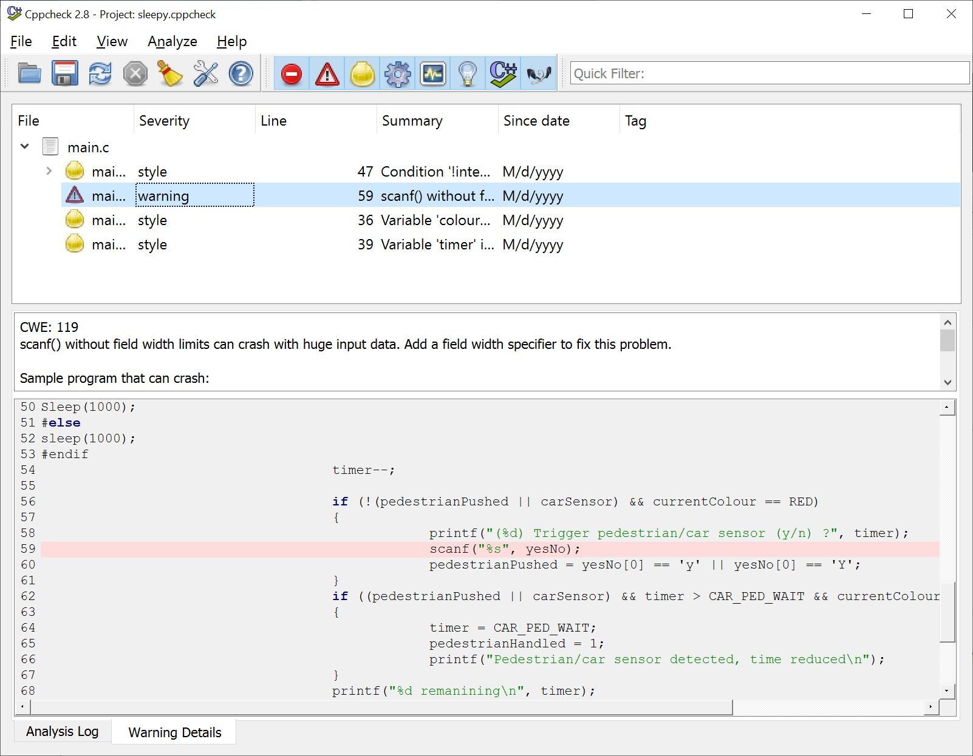
CPPcheck

Slide 10
Core Dumps
A much older debugging technique which are rarely used nowadays.
A copy of the memory allocated for program written it to a file.
In binary and is very laborious to go through by hand.
Automatic dumped readers which can allow you to explore these files in a more human readable way.
Notes:
Core dumps are a much older debugging technique which are rarely used nowadays. A core dump makes a copy of all of the memory allocated for program and writes it to a file. This information is in binary and is very laborious to go through by hand. There are automatic dump readers which can allow you to explore these files in a more human readable way. These files normally contain all the binary instructions and data for the program and tell you where the program was when it terminated. This has become a last resort debugging technique which can be used after a program fails.

Slide 11
Debug and Release Builds
Debug Mode:
It links to a set of libraries which have been compiled in debug mode.
It includes debugging information in an associated program database file.
It does not optimize the code to make it as fast as possible.
It might include additional runtime checks to pick up errors .
Slower compared to release mode.
Release Mode:
No longer includes all the debugging information.
Runs the optimizer to produce the fastest running code possible.

Slide 12
Conditional Compilation
We can turn debugging on an off with
#define DEBUG 1 ... if(DEBUG) printf("%s (%d): z=%d\n", __FILE__, __LINE__, z);
This does a check of the condition during runtime, slowing program
Conditional compilation is more efficient
#define DEBUG ... #ifdef DEBUG printf("%s (%d): z=%d\n", __FILE__, __LINE__, z); #endif

Slide 13
Compiled vs. Interpreted
Compiled
A compiler goes through the whole program at once before it runs
Detects problems before the program ever runs
Interpreted
Program is run line by line
Program is parsed only just before line is executed
Problems are not detected until line is executed
Rarely executed lines can make it to production with bugs in them because they were never executed

Slide 14
Strongly vs. Weakly Typed
Strongly typed
All assignments and function calls are check to make sure the right types are used
Errors detected at compilation time
Weakly typed
Variables and parameters can accept any type
Sending the wrong variable by mistake is not detected until the line is executed
Rarely executed lines can have errors in them that are not detected until months later.
Notes:
The languages we've dealt with so far have been strongly typed languages. A strongly typed language does a lot of type checking during the compilation process. As a result, it detects a great number of errors at compile time and you get to fix them before your program ever executes.
There is also a class of languages which are weakly typed. This means that when you pass a parameter to a function they don't actually check to see that the type of the parameter is correct. Further, some of these languages have variables where you don't even declare the type of the variable.t he type of the variable is determined by the value which is assigned to it and, if you assign a different value to the same variable, you can change the type of the variable. scripting languages like Bash as well as popular languages like Python and JavaScript.

